Slide 1
Parallel Algorithm Design
CS121 Parallel Computing
Fall 2024

Slide 2
Foster’s design methodology
Encourages development of scalable algorithms by delaying machine-dependent considerations until later steps.
I. Foster, Designing and Building Parallel Programs, Addison-Wesley, 1995, available online at http://www.mcs.anl.gov/~itf/dbpp/
Methodology has four steps
Partitioning
Communication
Agglomeration
Mapping

Slide 3
Outline
Overview of Foster’s methodology.
Data partitioning.
Example using Floyd-Warshall algorithm.
Algorithmic partitioning.

Slide 4
Foster’s design methodology

Slide 5
Partitioning
The application must be partitioned into a number of tasks that can execute in parallel.
Data partitioning
The application data is divided into parts and each task operates on a different part of the data.
Need to associate computations with the data.
Also known as domain decomposition.
Algorithmic partitioning
The algorithm is divided into a number of tasks that can execute in parallel.
Need to associate data with the tasks.
This often yields tasks that can be pipelined.
Also known as functional decomposition.

Slide 6
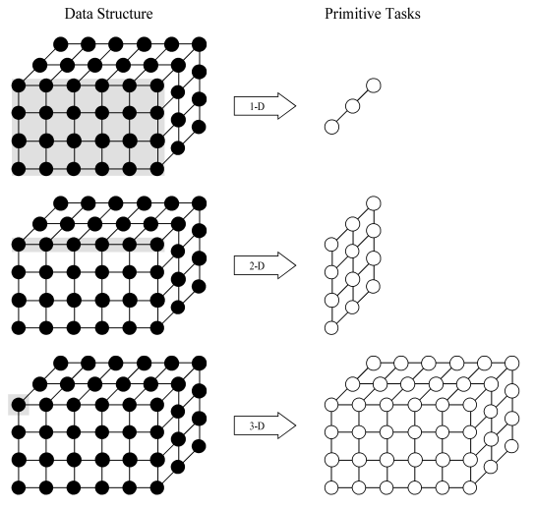
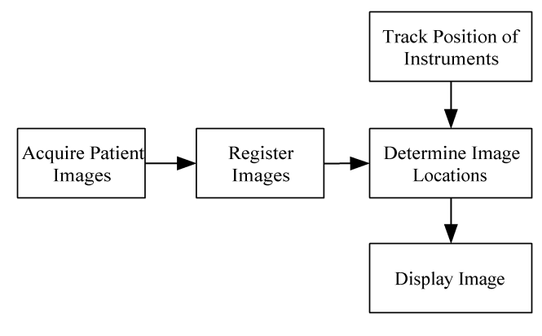
Partitioning
Data partitioning
The application data is divided into parts that can be operated on in parallel.
Algorithmic partitioning
The algorithm is divided into parts that can be executed in parallel.

Slide 7
Partitioning checklist
There should be at least 10x more primitive tasks than processors in the target computer.
Redundant computations and redundant data storage should be minimized.
The primitive tasks should be roughly the same size.
The number of tasks should be an increasing function of problem size.

Slide 8
Communication
Determine what data is passed between tasks.
Two kinds of communication
Local communication: A task needs values from a small number of other tasks (point-to-point),
Global communication: A number of tasks require or contribute data (collective).
Checklist
Communication should be balanced among tasks.
Each task should preferably communicate with only a small group of neighbours.
Tasks should be able to perform communications concurrently, i.e. no bottlenecks.
Task should be able to overlap computations and communication.

Slide 9
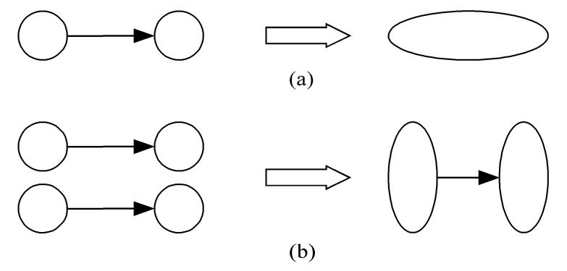
Agglomeration
Grouping tasks into larger (super)tasks.
Goal is to improve performance and simplify programming.
Eliminate communication between primitive tasks that are agglomerated into one task.
Combine groups of sending and receiving tasks so that fewer but larger messages are sent.

Slide 10
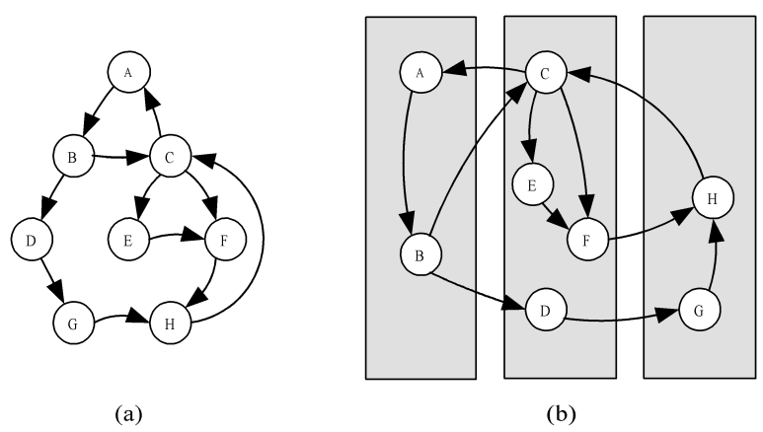
Mapping
Assigning (super)tasks to processors
With a distributed memory system, mapping can be done by the user.
Goals
Balance the load to maximize processor utilization.
Minimize interprocessor communication.
Sometimes two goals conflict. Look for best tradeoff.
If all tasks require the same amount of time, the above mapping would mean the middle processor takes twice as long as the other two.

Slide 11
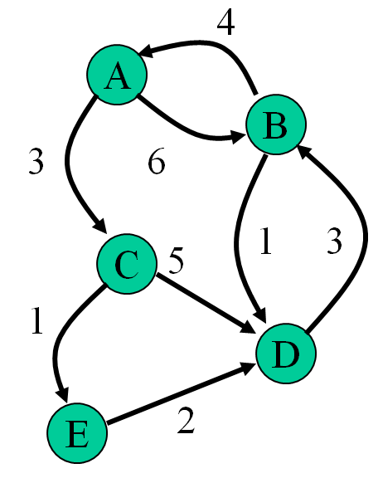
All pairs shortest path problem
Given a weighted directed graph of vertices and edges.
There may be an edge from vertex i to j, but not from j to i.
Edge weight from vertex i to j may be different to from j to i.
Find the shortest path between every pair of vertices.
Applications
Shortest route on a road / communication network.
Efficient solution in a state space graph.

Slide 12
Example
Represent graph using adjacency matrix.
a[i,j] = 0 if i = j.
For i ≠ j, a[i,j] = length of edge from i to j, or ∞ if no edge.
Output matrix of shortest path lengths, or ∞ if no path.
Assume no negative weight cycles for simplicity.
A
B
C
D
E
A
B
C
D
E
A
0
6
3
∞
∞
A
0
6
3
6
4
B
4
0
∞
1
∞
B
4
0
7
10
8
C
∞
∞
0
5
1
C
10
6
0
3
1
D
∞
3
∞
0
∞
D
7
3
10
0
11
E
∞
∞
∞
2
0
E
9
5
12
2
0

Slide 13
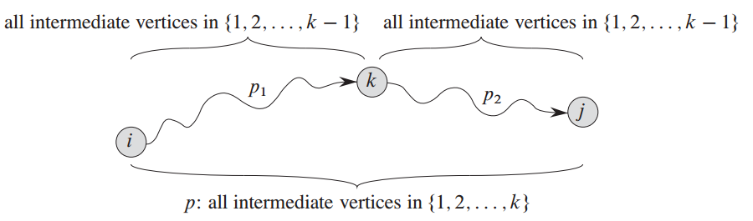
Floyd-Warshall algorithm
Consider the shortest path from i to j using only nodes 1,...,k as intermediate nodes.
Intermediate node is a node on the path besides i and j.
If the path doesn’t exist, indicate its distance by ∞.
Assume a path exists. Then it either uses node k or not.
In the first case, k occurs once in path from i to j.
The path consists of a subpath from i to k using 1, ..., k-1 as intermediate nodes, and a path from k to j using 1, ..., k-1 as intermediate nodes.
In the second case, the path only uses nodes 1,...,k-1.
Source: Introduction to Algorithms, Cormen et al.

Slide 14
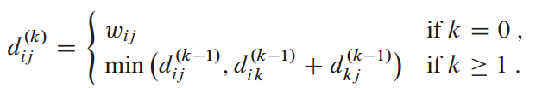
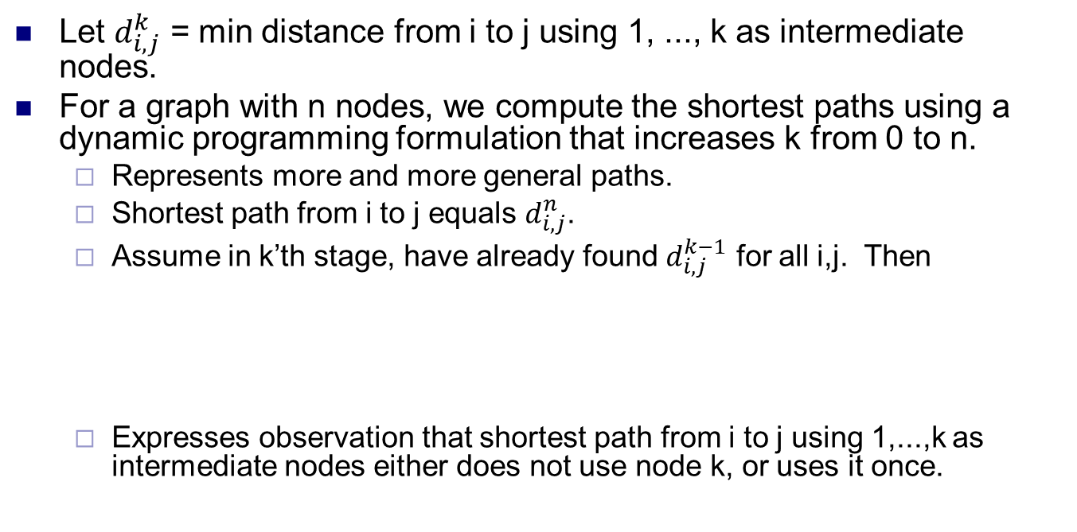
Floyd-Warshall algorithm
Let $d_{i,j}^{k}$ = min distance from i to j using 1, ..., k as intermediate nodes.
For a graph with n nodes, we compute the shortest paths using a dynamic programming formulation that increases k from 0 to n.
Represents more and more general paths.
Shortest path from i to j equals $d_{i,j}^{n}$.
Assume in k’th stage, have already found $d_{i,j}^{k−1}$ for all i,j. Then
Expresses observation that shortest path from i to j using 1,...,k as intermediate nodes either does not use node k, or uses it once.

Slide 15
Parallelization: partitioning
for (k = 0; k < n; k++)
for (i = 0; i < n; i++)
for (j = 0; j < n; j++)
a[i, j] = min(a[i, j], a[i, k] + a[k, j]);
To parallelize this algorithm, observe for each k, all assignments can be done independently.
I.e. a[i,j] and a[i’,j’] can be computed in either order, for all i,i’,j,j’.
a[i,j] depends on a[i,k] and a[k,j].
But a[i,k]=min(a[i,k], a[i,k] + a[k,k]), where a[k,k]=0.
So a[i,k] doesn’t change in iteration k. Similarly for a[k,j].
So no matter when a[i,j] is computed during phase k, it has same value. Same for a[i’,j’]. So a[i,j] and a[i’,j’] are independent.
Parallel algorithm runs n phases sequentially (one for each k). In each phase, all n² assignments done in parallel.

Slide 16
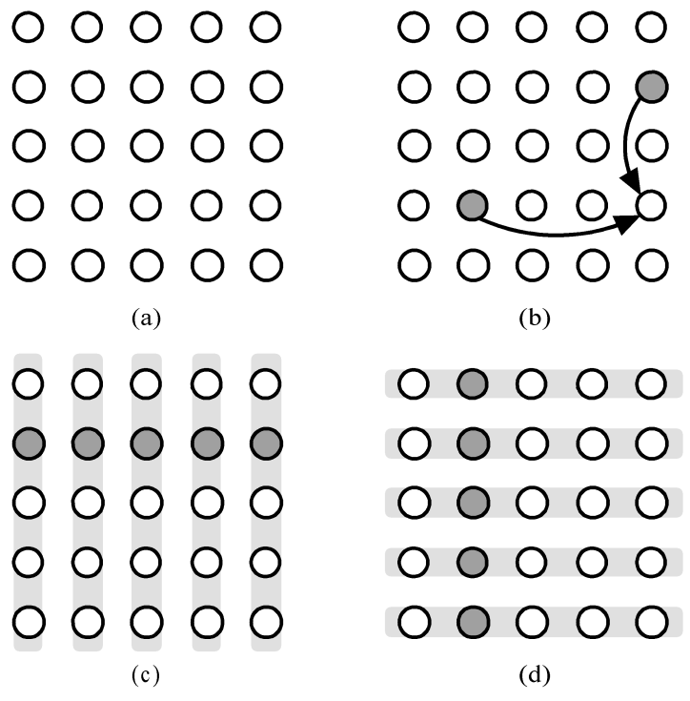
Parallelization: communication
Communication in each phase
a[i,j] = min(a[i,j], a[i,k]+a[k,j])
Updating a[3,4] when k=1.
In general, every entry in row i needs a[i,k], and every entry in column j needs a[k,j].
The primitive tasks
So in phase k, a[k,j], for each j, broadcasts its value to the j’th column.
Also, a[i,k], for each i, broadcasts its value to the i’th row.

Slide 17
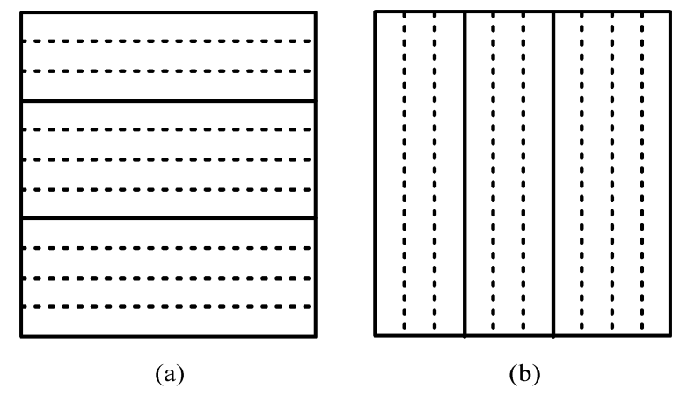
Agglomeration and mapping
Number of tasks is static, always n².
Computation time per task is constant.
Agglomerate tasks to minimize communication.
Create one task per MPI process.
Can choose either (a) row striping, or (b) column striping.
Row striping more convenient in C.
Each process has a strip of rows, avoid communication within same strip (row).
Each process has a strip of columns, avoid communication within same strip (column).

Slide 18
MPI pseudocode
Assume n × n matrix on p processors (n exactly divisible by p), where part[i,j] holds strip of rows of i’th processor.
We’re ignoring code to distribute matrix and collect results.
s = n/p; /* rows in strip */
for (k = 0; k < n; k++) {
root = k/s; /* owner of row */
if (myrank == root) {
offset = k – myrank*s; /* offset of row */
for (j = 0; j < n; j++) /* copy row */
temp[j] = part[offset][j];
}
bcast(temp, n, root, P_{group}); /* broadcast row */
for (i = 0; i < s; i++) /* update strip */
for (j = 0; j < n; j++)
part[i][j] =
min(part[i][j], part[i,k] + temp[j]); }

Slide 19
Analysis of algorithm
Sequential running time t_{s} = O(n³).
Parallel execution
In each iteration of k, there is a communication phase and a computation phase.
Communication phase
Broadcast row to other processors
t_{comm} = (t_{startup} + 4 n t_{data}) log p, assuming each element 4 bytes.
Computation phase t_{comp} = cn² / p.
Total time
t_{p} = n (t_{startup} + 4 n t_{data} log p + cn² / p ) = O(n² log p + n³ / p).
Speedup
t_{s} / t_{p} = O(n³) / O(n² log p + n³/p) = O(p).

Slide 20
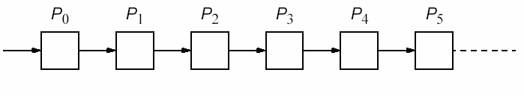
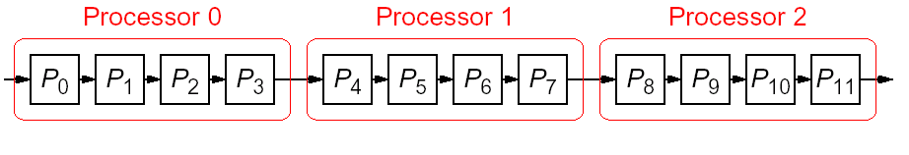
Algorithmic partitioning
Divide an algorithm into several parts, each taking turns processing the data.
One example is pipelined computations.
The problem is divided into a sequence of steps.
The steps must be executed one after another.
Each step is executed by a separate task.
If number of stages in pipeline is greater than number of processors, assign group of steps to each processor.

Slide 21
Example: sum of sequence
Power series for sin θ = θ - θ³/3! + θ⁵/5! - θ⁷/7! + …
The loop could be unfolded to give.
r = theta;
sum = theta;
for (i=1; i < p; i++) {
r = – r*theta*theta/(2*i*(2*i+1));
sum = sum + r;
}
sum = theta;
sum = sum - theta³/3!;
sum = sum + theta⁵/5!;
sum = sum - theta⁷/7!;
…

Slide 22
Pipeline for unfolded loop
Use as many stages (tasks) as required by the precision of the result.
Can pass θ, partial product and partial sum to next processor in pipeline.
More details in later slide.
θ
θ-θ³/3!
θ-θ³/3!+θ⁵/5!
θ-…±θ^{2p-1}/(2p-1)!
P₀
P₁
P₂
P_{p-1}

Slide 23
Types of pipelines
Assuming problem can be divided into a series of sequential tasks, pipelined approach can provide increased execution speed under the following three types of computations.
If more than one instance of the problem is to be executed.
If a series of data items must be processed, each requiring multiple operations.
If information to start the next process can be passed forward before the process has completed all its internal operations.

Slide 24
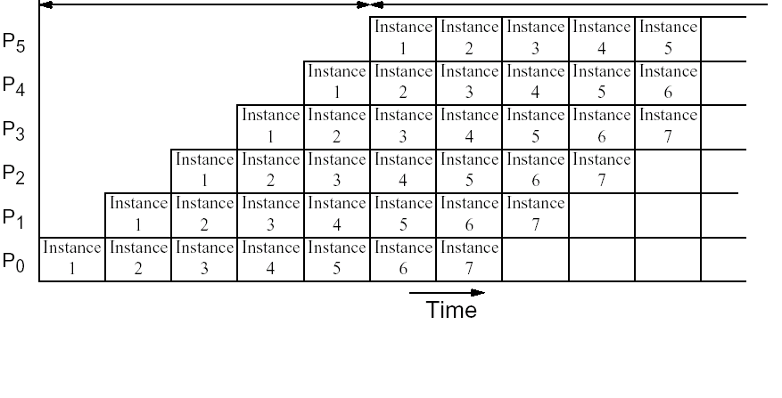
Type 1: Space-time diagram
p - 1
m
p-stage pipeline on p processors.
m instances of the problem.
Execution time = m + p – 1.

Slide 25
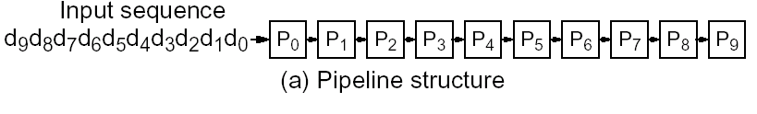
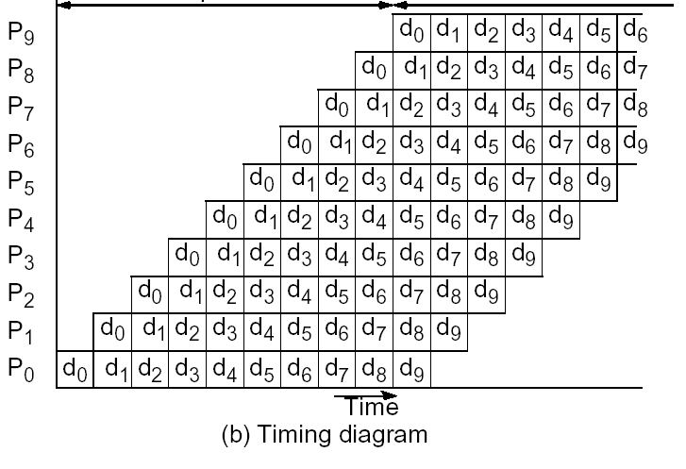
Type 2: Space-time diagram
p - 1
n
p-stage pipeline on p processors
n data items
Execution time = n + p - 1

Slide 26
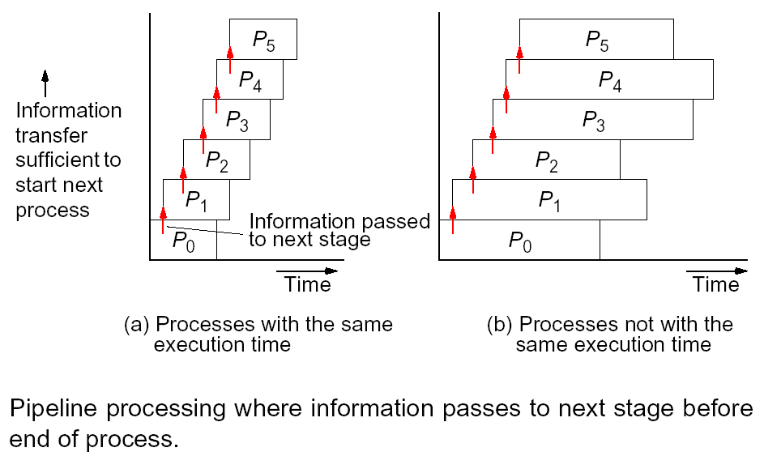
Type 3: Space-time diagram

Slide 27
Analysis of types 1 and 2
Assumptions and model
p processors performing p stages (tasks).
Each task consists of a number of cycles, i.e. basic units of computation.
All cycles of all tasks take about same amount of time, say t_{cycle}.
Parallel execution time t_{p} = t_{cycle}* n_{c}.
Time for one cycle t_{cycle} = t_{comp} + t_{comm}.
Number of cycles n_{c} given by space-time diagram.
For type 1, n_{c} = m + p – 1 for m instances.
For type 2, n_{c} = n + p – 1 for n data items.

Slide 28
Sum of sequence (type 1)
Power series sin θ = θ - θ³/3! + θ⁵/5! - θ⁷/7! + ...
θ
θ-θ³/3!
θ-θ³/3!+θ⁵/5!
θ-…±θ^{2p-1}/(2p-1)!
P₀
P₁
P₂
P_{p-1}
if (myrank == 0) /* first */
send(theta, theta, theta, P₁);
else /* not first */
recv(&theta, &r, &sum, P_{i-1});
r = – r*theta*theta/(2*i*(2*i+1));
sum = sum + r;
if (myrank < p-1 ) /* not last */
send(theta, r, sum, P_{i+1});
}
/* final result in P_{p-1} */

Slide 29
Analysis
Parallel execution
Use most complex cycle to upper bound computation time.
Computation time t_{comp} = O(1).
Communication time t_{comm} = 2(t_{startup}+3t_{data}).
Time for one cycle t_{cycle} = t_{comp} + t_{comm}.
Single instance of problem
Number of cycles n_{c} = p for single instance.
Time t_{p} = t_{cycle}* n_{c} = p(2(t_{startup}+3t_{data}) + O(1)).
recv(&theta, &r, &sum, P_{i-1});
r = – r*theta*theta/(2*i*(2*i+1));
sum = sum + r;
send(theta, r, sum, P_{i+1});

Slide 30
Analysis
Pipeline is efficient only if we have more than one problem to solve, i.e. more than one value of θ.
Assume we compute sin for m values of θ.
Parallel execution
Number of cycles n_{c} = m + p - 1 for m instances.
Time t_{p} = t_{cycle}* n_{c} = (2(t_{startup}+3t_{data}) + O(1)) * (m+p-1).
Average execution time per instance is t_{a} = t_{p} /m = O((m + p) / m).
For large m (i.e. continuous supply of values of θ) average execution time per instance is
t_{a} = 2(t_{startup} + 3t_{data}) + O(1) = O(1).
A result is produced each constant number of pipeline cycles.

Slide 31
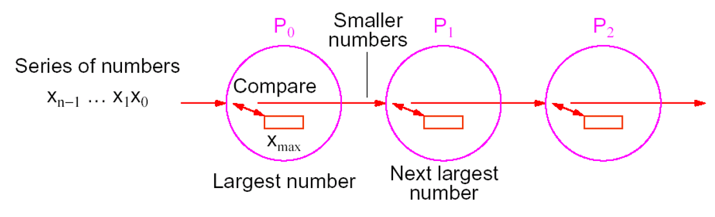
Insertion sort (type 2)
Use a pipeline to sort n numbers in decreasing order using p = n processors.
Each processor stores the largest number received so far and passes on all smaller numbers.
If a new number is larger than the currently stored number, the stored number is passed on and replaced by the new number
When all numbers have been passed through the pipeline, P₀ has the largest number, P₁ has next largest number, etc.

Slide 32
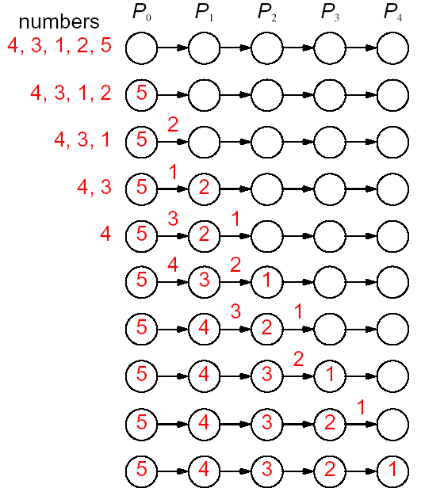
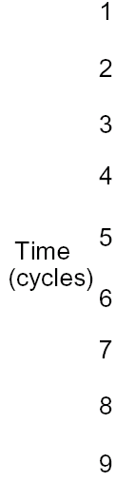
Insertion sort
2 steps
i) store
ii) compare/pass on

Slide 33
Insertion sort
Initialization and basic cycle for P_{i}.
x is current max value at P_{i}.
Process P_{i} needs to pass on (n - i - 1) numbers, as there are (n - i - 1) processors to its right.
It executes the basic cycle (n - i - 1) times.
recv(&number, P_{i-1});
if (number > x) {
send(x, P_{i+1});
x = number;
}
else
send(number, P_{i+1});

Slide 34
Analysis
Sequential execution
t_{s} = (n-1) + (n-2) + … + 2 + 1 = n (n-1) / 2 = O(n²).
Parallel execution
Each basic cycle consists of one recv, one send and a compare/exchange operation.
Computation time t_{comp} = 3.
Communication time t_{comm} = 2(t_{startup} + t_{data}).
Time for one cycle t_{cycle} = t_{comp} + t_{comm}
Number of cycles n_{c} = n + p - 1 = 2n – 1.
Time t_{p} = t_{cycle}* n_{c} = (2(t_{startup} + t_{data}) + 3) * (2n - 1) = O(n).

Slide 35
Solving linear equations (type 3)
Solving linear equations in upper (or lower) triangular form.
Used in Gaussian elimination.
Process P_{i} behaves as follows.
Receives partial solution from P_{i-1}.
Passes on partial solution to P_{i+1}.
Computes next part of solution and sends to P_{i+1}.
This is a type 3 pipeline computation.
Each process has a different computation time.

Slide 36
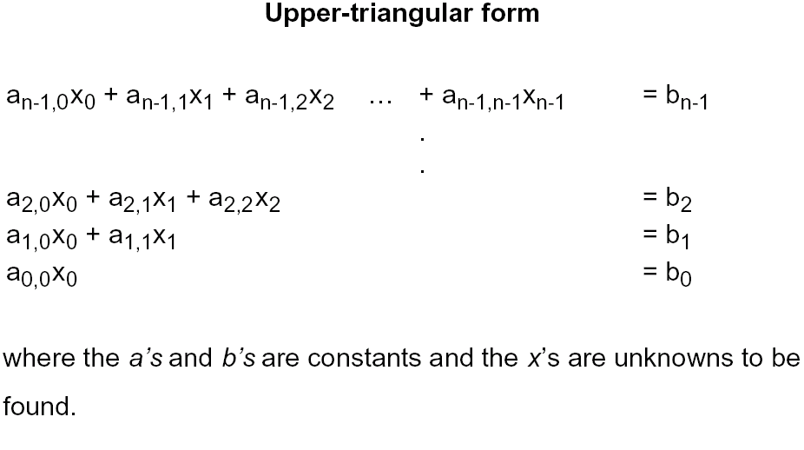
Solving linear equations

Slide 37
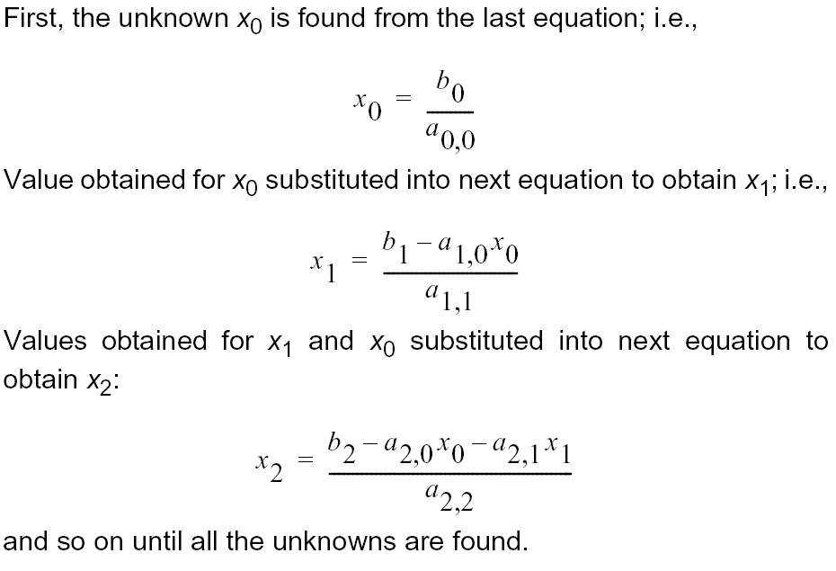
Back substitution

Slide 38
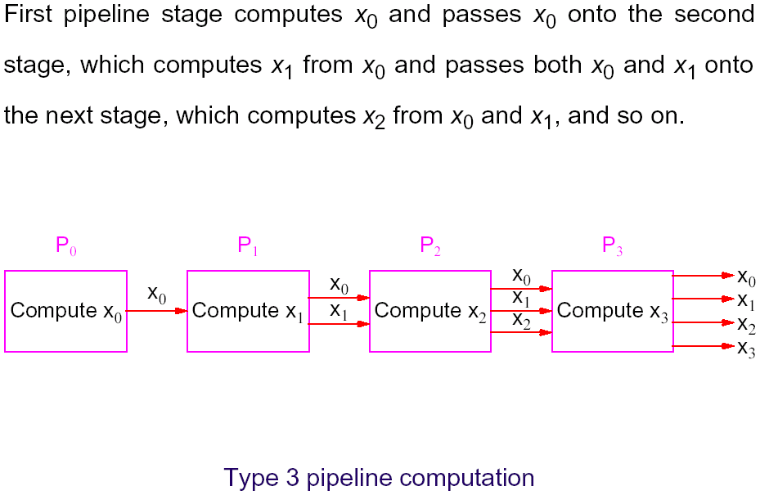
Pipeline solution
p = n
n equations
n unknowns

Slide 39
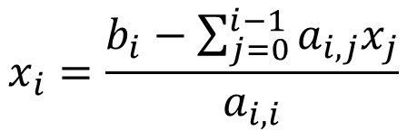
Parallel code
Process P_{i} (0 < i < n)
Process P₀
p = n stages, with final result on P_{n}.
sum = 0;
for (j = 0; j < i; j++) {
recv(&x[j], P_{i-1});
send(x[j], P_{i+1});
sum = sum + a[i][j] * x[j];
}
x[i] = (b[i] - sum) / a[i][i];
send(x[i], P_{i+1});
$$x_{i}=\frac{b_{i}−\sum_{j=0}^{i−1}{a_{i,j}x_{j}}}{a_{i,i}}$$
x[0] = b[0] / a[0][0];
send(x[i], P_{i+1});

Slide 40
Analysis
Sequential execution
Iteration i of loop performs i multiplications and additions, one subtraction and one division.
t_{s} = O(1+2+...+n-1) = O(n²).
Parallel execution
Process P_{i} performs i multiplications and additions, one subtraction and one division.
Process P_{i} has one recv and one send before process P_{i+1} can start, so time to pass data is 2(t_{startup} + t_{data}).
Process P_{n-1} starts at time (n-1) * 2(t_{startup} + t_{data}).

Slide 41
Analysis
Parallel execution
Process P_{n-1} performs n-1 multiplications and additions, one division and one subtraction.
Computation time t_{comp} = 2(n-1) + 2.
Process P_{n-1} has (n-1) recv and n sends.
Communication time t_{comm} = (2n-1)(t_{startup} + t_{data}).
Time t_{p} = (n-1) *2(t_{startup} + t_{data}) + (2n-1) (t_{startup} + t_{data}) + 2(n-1) + 2 = O(n).
Speedup = t_{s} / t_{p}= O(n) with n processors.

